Slide 1
CPU Scheduling

Slide 2
Basic Concepts
CPU scheduling- forms the basis of multiprogrammed systems
Maximum CPU utilization obtained with multiprogramming
CPU–I/O Burst Cycle – Process execution consists of a cycle of CPU execution and I/O wait.
CPU burst distribution

Slide 3
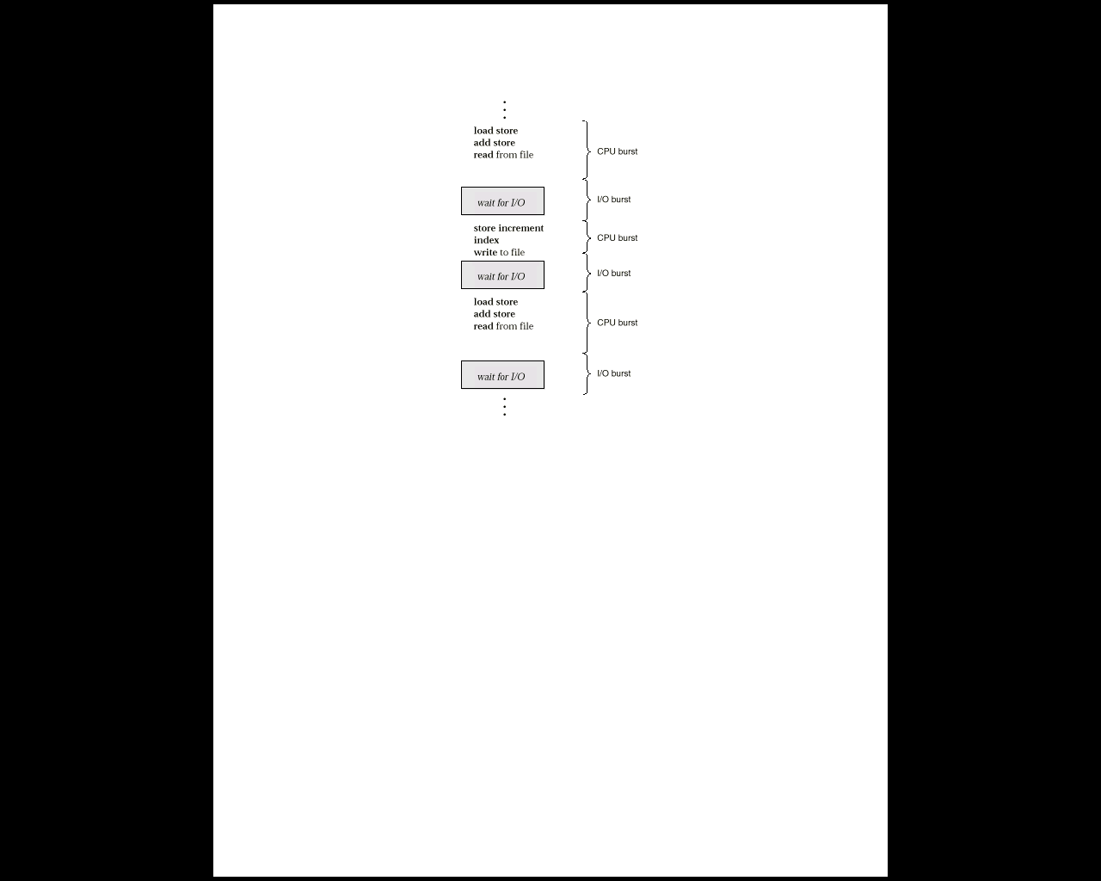
Alternating Sequence of CPU And I/O Bursts
Process execution begins with a CPU burst. That is followed by an I/O burst, then another CPU burst, then another I/O burst, and so on.
Eventually, the last CPU burst will end with a system request to terminate execution, rather than with another I/O burst

Slide 4
CPU Scheduler
Selects from among the processes in memory that are ready to execute, and allocates the CPU to one of them.
CPU scheduling decisions may take place when a process:
1.Switches from running to waiting state. (for example, I/O request, or invocation of wait for the termination of one of the child processes)
2. Switches from running to ready state. (for example, when an interrupt occurs)
3. Switches from waiting to ready. (for example, completion of I/O)
4. Terminates.
When scheduling takes place only under circumstances 1 and 4, we say the scheduling scheme is nonpreemptive; otherwise, the scheduling scheme is preemptive.
Under nonpreemptive scheduling, once the CPU has been allocated to a process, the process keeps the CPU until it releases the CPU either by terminating or by switching to the waiting state.

Slide 5
Dispatcher
Dispatcher module gives control of the CPU to the process selected by the short-term scheduler; this involves:
switching context
switching to user mode
jumping to the proper location in the user program to restart that program
Dispatch latency – time it takes for the dispatcher to stop one process and start another running.

Slide 6
Scheduling Criteria
CPU utilization – keep the CPU as busy as possible
Throughput – # of processes that complete their execution per time unit
Turnaround time – amount of time to execute a particular process
Waiting time – amount of time a process has been waiting in the ready queue
Response time – amount of time it takes from when a request was submitted until the first response is produced. (a process can produce some output fairly early, and can continue computing new results while previous results are being output to the user.)

Slide 7
Optimization Criteria
Max CPU utilization
Max throughput
Min turnaround time
Min waiting time
Min response time

Slide 8
First-Come, First-Served (FCFS) Scheduling
Process Burst Time(ms)
P₁ 24
P₂ 3
P₃ 3
Suppose that the processes arrive in the order: P₁ , P₂ , P₃ The Gantt Chart for the schedule is:
Waiting time for P₁ = 0; P₂ = 24; P₃ = 27
Average waiting time: (0 + 24 + 27)/3 = 17
P₁
P₂
P₃
0
24
27
30

Slide 9
Suppose that the processes arrive in the order
P₂ , P₃ , P₁ .
The Gantt chart for the schedule is:
Waiting time for P₁ = 6; P₂ = 0; P₃ = 3
Average waiting time: (6 + 0 + 3)/3 = 3
Much better than previous case.
The effect short process behind long process
P₂
P₃
P₁
0
3
6
30

Slide 10
Multilevel Queue
Ready queue is partitioned into separate queues: foreground (interactive) background (batch)
Each queue has its own scheduling algorithm, foreground – RR background – FCFS
Scheduling must be done between the queues.
Fixed priority scheduling; (i.e., serve all from foreground then from background). Possibility of starvation.
Time slice – each queue gets a certain amount of CPU time which it can schedule amongst its processes; i.e., 80% to foreground in RR 20% to background in FCFS

Slide 11
Let us look at an example of a multilevel queue-scheduling algorithm with five queues:
1. System processes
2. Interactive processes
3. Interactive editing processes
4. Batch processes
5. Student processes
Each queue has absolute priority over lower-priority queues. No process in the batch queue, for example, could run unless the queues for system processes, interactive processes, and interactive editing processes were all empty.
If an interactive editing process entered the ready queue while a batch process was running, the batch process would be preempted. Solaris 2 uses a form of this algorithm.

Slide 12
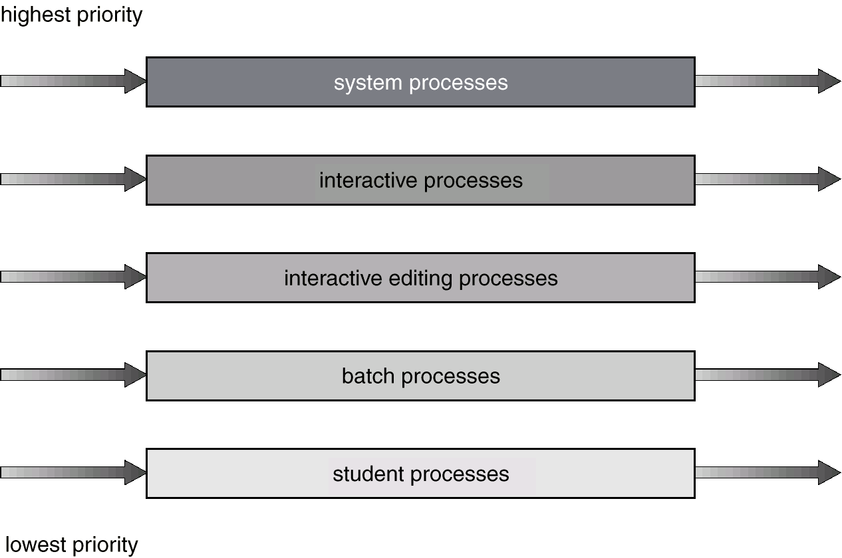
Multilevel Queue Scheduling

Slide 13
Multilevel Feedback Queue
A process can move between the various queues; aging can be implemented this way.
Multilevel-feedback-queue scheduler defined by the following parameters:
number of queues
scheduling algorithms for each queue
method used to determine when to upgrade a process
method used to determine when to demote a process
method used to determine which queue a process will enter when that process needs service

Slide 14
Example of Multilevel Feedback Queue
This scheduling algorithm gives highest priority to any process with a CPU burst of 8 milliseconds or less. Such a process will quickly get the CPU, finish its CPU burst, and go off to its next I/O burst. Processes that need more than 8, but less than 16, milliseconds are also served quickly, although with lower priority than shorter processes. Long processes automatically sink to queue 2 and are served in FCFS order with any CPU cycles left over from queues 0 and 1.

Slide 15
